Slide 1
Introduction to ICT Skills
Mr. Anwar Khan
Lecturer CS Dept

Slide 2
General Class Rules
Your Class attendance is very Important.
  Please try to come in time. If you come to the class after 10 minutes, you will be marked absent.
  If marked absent, please don’t come to me as your absence in the class may not be converted into presence.
Submit your assignment on time.
Copied assignments will not be accepted.
2
1A-<number>

Slide 3
General Class Rules Cont’d
Switch your cell phones off.
Contact your CR for notes.
There will be Surprise Graded Quizzes in every Chapter. Be prepared !
Your Sessional Marks will be calculated from your Quizzes and Assignments.
3
1A-<number>

Slide 4
Grading Criteria
Assignments
Quizzes
Presentation
Mid Term Exam
Final Exam
Attendance
10
10
10
20
40
10
1A-<number>

Slide 5
Introduction to ICT Skills
Course Number: CS092881
Credits: 3
Prerequisite: None
Instructor: Mr. Anwar Khan
Office: Faculty office SF-05
email: anwar.khan@cs.uol.edu.pk
Office Hours: Monday-Friday 8AM-4:00PM
Objective: Introduction to computer science through extensive course
projects.
5
1A-<number>

Slide 6
Introduction to ICT Skills
Textbook:
P. Norton, Peter Norton’s
Introduction to Computers, 7th Ed.,
McGraw-Hills
1A-<number>

Slide 7
Chapter 1: Introducing Computer Systems
Lesson 1A: Exploring Computers and Their Uses
Lesson 1B: Looking Inside the Computer System
1A-<number>

Slide 8

McGraw-Hill Technology Education
Copyright © 2006 by The McGraw-Hill Companies, Inc. All rights reserved.

Slide 9
Chapter 1A
Introducing Computer Systems

Slide 10
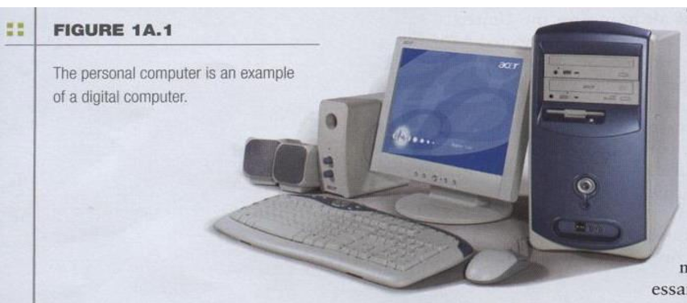
The Computer Defined
Electronic device
Converts data into information
Modern computers are digital
– Two digits combine to make data (0, 1)
1A-<number>

Slide 11
What is a Computer?
A computer is an electronic device that process data, converting it into information that is useful to people.
A computer is controlled by the programmed instructions, which give the machine a purpose and tell what to do.
1A-<number>

Slide 12
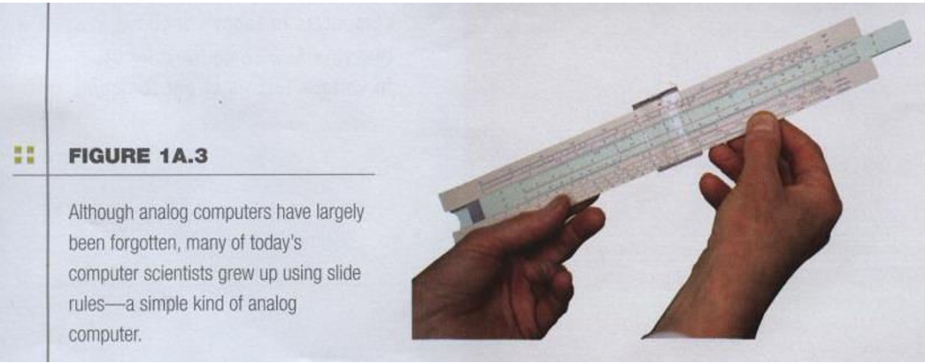
The Computer Defined
Older computers were analog
– A more manageable type -- the old-fashioned slide rule
1A-<number>

Slide 13
Types of Computers
Types of Computer on basis of usage
30
Computers for Individual Use
Computers for Organizations
Workstations
Desktop Computers
Notebook Computers
Tablet Computers
Handheld Computers
Smart Phones
Network Servers
Mainframe Computers
Mini Computers
Super Computers
1A-<number>

Slide 14
Computers For Individual Use
Desktop computers
  The most common type of computer
  Sits on the desk or floor
  Performs a variety of tasks
Workstations
  Specialized computers
  Optimized for science or graphics
  More powerful than a desktop
1A-<number>
Notes:
Insider information
System units are commonly called cases. Many computer enthusiasts customize or ‘mod’ their cases with windows and lights. See www.casemodgod.com for examples of cases and products.
Sun Microsystems makes the most popular workstations on the planet. Sun’s systems are used in diverse applications such as medical imaging and CGI (computer generated image) animation.

Slide 15
Computers For Individual Use
Notebook computers
  Small portable computers
  Weighs between 3 and 8 pounds
  About 8 ½ by 11 inches
  Typically as powerful as a desktop
  Can include a docking station
1A-<number>
Notes:
Discussion point
Have students contrast desktop and notebook computers. Focus on the pros and cons of each type of computer.

Slide 16
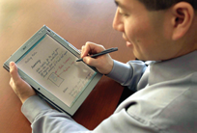
Computers For Individual Use
Tablet computers
  Newest development in portable computers
  Input is through
  a pen
  Run specialized versions of office products
1A-<number>
Notes:
Teaching tip
The tablet PC was designed to simulate a piece of paper. Users interact with the tablet as if it was an unlimited paper notebook.
For more information
See www.microsoft.com/windowsxp/tabletpc/evaluation/tours/default.mspx for an example of the Tablet PC in action.

Slide 17
Computers For Individual Use
Handheld computers
  Very small computers
  Personal Digital Assistants (PDA)
  Note taking or contact management
  Data can synchronize with a desktop
Smart phones
  Hybrid of cell phone and PDA
  Web surfing, e-mail access
1A-<number>
Notes:
Teaching tip
At this point, refer the students to the productivity tip on page 13. This tip helps the student determine what type of PC is best for them.

Slide 18
Computers For Organizations
Network servers
  Centralized computer
  All other computers connect
  Provides access to network resources
  Multiple servers are called server farms
  Often simply a powerful desktop
1A-<number>

Slide 19
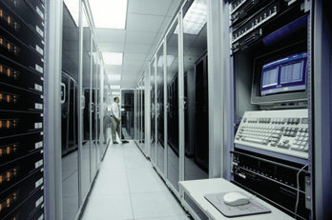
Computers For Organizations
Mainframes
  Used in large organizations
  Handle thousands
  of users
  Users access through a terminal
1A-<number>

Slide 20
Computers For Organizations
Minicomputers
  Called midrange computers
  Power between mainframe and desktop
  Handle hundreds of users
  Used in smaller organizations
  Users access through a terminal
1A-<number>

Slide 21
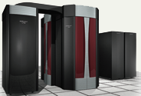
Computers For Organizations
Supercomputers
  The most powerful computers made
  Handle large and complex calculations
  Process trillions of operations per second
  Found in research organizations
1A-<number>
Notes:
Teaching tip
Students have a hard time understanding trillions of calculations. A simple explanation is to add 1 trillion random numbers together in a second. Contrast the speed of a super computer to the fastest desktop computer advertised during the week of class.

Slide 22
Computers In Society
More impact than any other invention
  Changed work and leisure activities
  Used by all demographic groups
Computers are important because:
  Provide information to users
  Information is critical to our society
  Managing information is difficult
1A-<number>

Slide 23
Computers In Society
Computers at home
  Many homes have multiple computers
  Computers are used for
    Business
    Entertainment
    Communication
    Education
1A-<number>
Notes:
Insider information
The 2000 Census determined that 51% of American households had computers. Over 42% of these households also had Internet access. This can be contrasted to 36% and 18% in 1997. See www.census.gov/prod/2001pubs/p23-207.pdf for more information.

Slide 24
Computers In Society
Computers in education
  Computer literacy required at all levels
Computers in small business
  Makes businesses more profitable
  Allows owners to manage
Computers in industry
  Computers are used to design products
  Assembly lines are automated
1A-<number>
Notes:
Insider information
Specialized mountain bikes are designed on Sun workstations.

Slide 25
Computers In Society
Computers in government
  Necessary to track data for population
    Police officers
    Tax calculation and collection
  Governments were the first computer users
1A-<number>
Notes:
Teaching tip
Most state departments of motor vehicles rely on a mainframe computer. Officers access the mainframe from a remote intelligent terminal.

Slide 26
Computers In Society
Computers in health care
  Revolutionized health care
  New treatments possible
  Scheduling of patients has improved
  Delivery of medicine is safer
1A-<number>
Notes:
Discussion point
Page 19 of the text introduces the first Norton Notebook, the Merging of Media and Meaning. The author draws an analogy between electricity and computers in our lives. Discuss with your students how difficult live would be without either of these devices. Remember that computers exist in nearly all of our modern devices, including cars, phones, kitchen appliances and entertainment devices.

Slide 27
Chapter 1A
End of Chapter

